Slide 1
WHAT IS LIGHTGBM?
LightGBM (Light Gradient Boosting Machine) is a fast, efficient gradient boosting algorithm developed by Microsoft.
It’s similar to XGBoost, but it’s designed to be faster and use less memory, especially with large datasets.

Slide 2
HOW LIGHTGBM WORKS
It builds multiple decision trees one after another -each tree tries to correct the errors made by the previous ones by two methods.
Leaf-wise Tree Growth: Grow tree leaf by leaf -always expanding the leaf with the largest error.
Histogram-based Binning: LightGBM groups continuous values into bins.

Slide 3
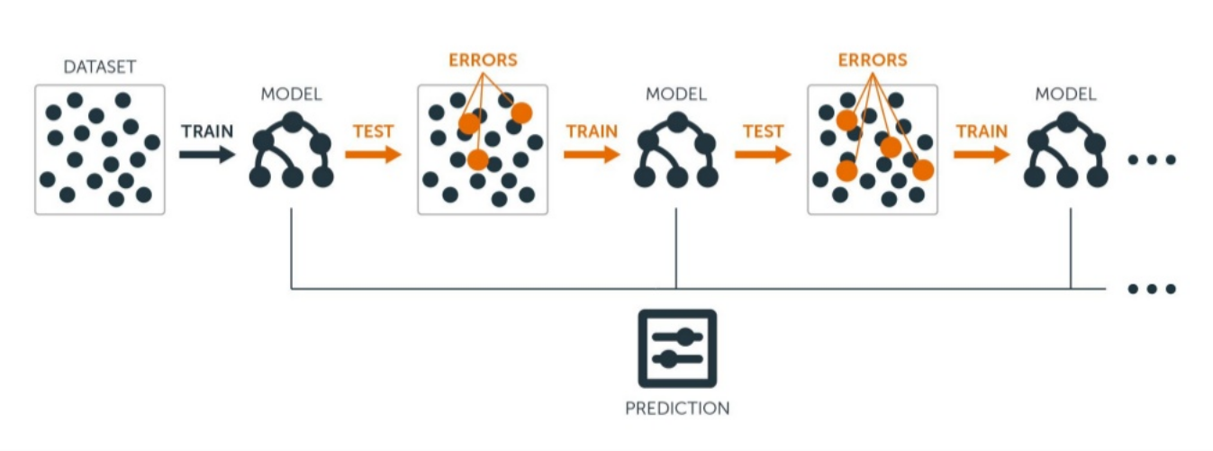
WORKFLOW

Slide 4
IMPLEMENTATION
pip install lightgbm
import lightgbm as lgb
model = lgb.LGBMRegressor(
boosting_type='gbdt', num_leaves=31,
learning_rate=0.05,
n_estimators=100
)

Slide 5
ADVANTAGES
Fast training speed (much faster than XGBoost on large data)
Low memory usage
High accuracy
Handles large datasets efficiently
Supports parallel and GPU learning
Works with categorical features directly

